Slide 1
Overview of the Cloud
AWS Essentials
SoftUni Team
Technical Trainers
Software University
https://softuni.org

Slide 2
Table of Contents
1. In the Beginning, Before There Was a Cloud
2. Introduction to Cloud Terminology
3. Primary Benefits of Cloud/AWS
4. AWS Global Infrastructure
5. Website Deployment Workshop
2
Notes:
2

Slide 3
Have a Question?
sli.do
# AWS-essentials
Notes:
3

Slide 4

In the Beginning, Before There Was a Cloud

Slide 5

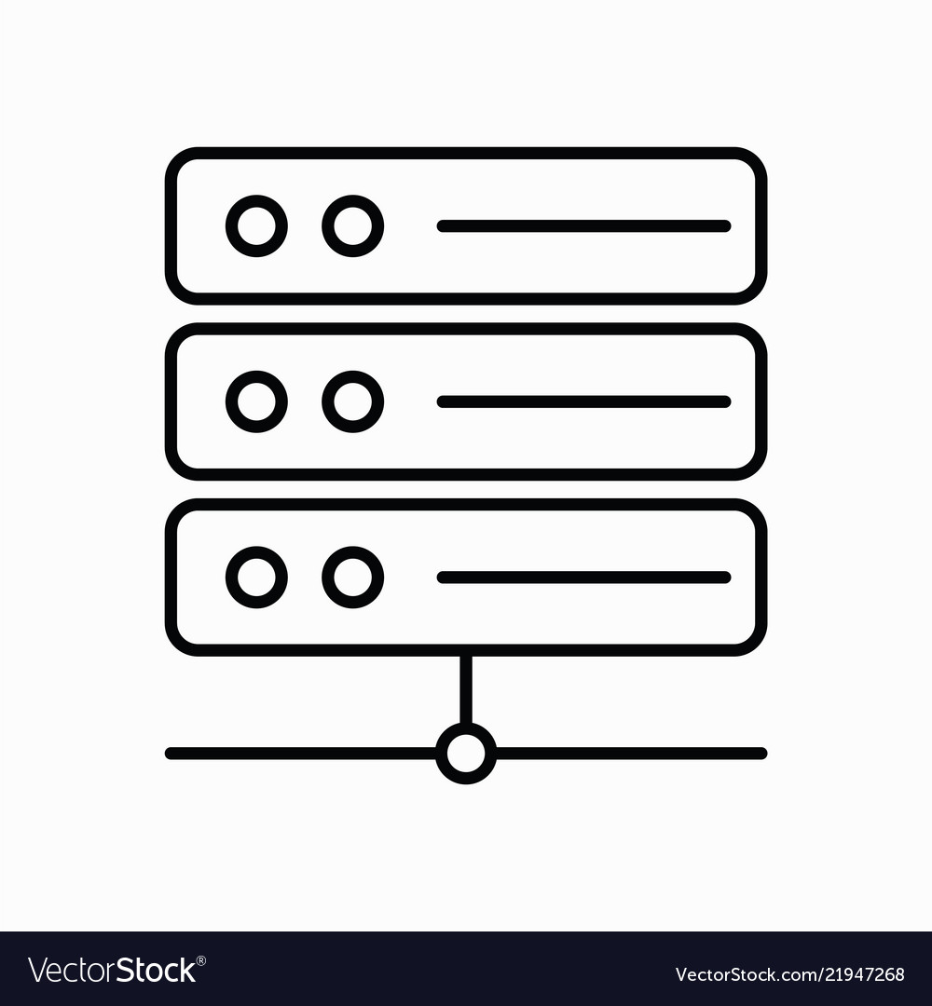
Traditional Client – Server Architecture

Slide 6



Typical Components to Support an Application
Compute
Storage
Network
Database

Slide 7

Data Center Growth
Alot of unutilised server capacity
Hard to control costs

Slide 8
Business Challenges
Cost Control
Disributed Workforce
Slow Provisioning
Data Center Challenges
Sprawl/Space
Power
Cooling

Slide 9

Introduction to Cloud Terminology

Slide 10
What is Cloud Computing?
Cloud services are typically hardware (infrastructure) and application services provided over the internet.
Infrastructure as a Service
Cloud Services
Platform as a Service
Software as a Service

Slide 11
Cloud Computing
Application
Software as a Service
VM
VM
VM
VM
Platform as a Service
Compute
Hypervisor
Storage
Infrastructure as a service
Network

Slide 12
Types of Cloud
Private cloud
Hybrid cloud
Public cloud
Fully Customizable
Higher Security
Capital Costs
High Overhead
Lack of elasticity
Potential Latency
Combination of public and private
Often used as a transition to public cloud
Addes flexability and scalability
No Capital Costs
Pay as you go
Low overhead
Infinite scalability
Elasticity
Governance challenges
Simplified deployments

Slide 13

Cloud Terminology

Slide 14
Cloud Terminology (1)
Scalable (scalability)
The ability to easily grow in size, capacity and/or scope (usually based on demand)
1000 Users
5000 Users
50 000 Users

Slide 15
Cloud Terminology (2)
Elastic (elasticity)
The ability to not only grow in size (scale), but also reduce in size when required
1000 Users
5000 Users
50 000 Users

Slide 16
Cloud Terminology (3)
Fault Tolerant
The ability to withstand a certain amount of failure and still remain functional (and/or be self-healing and return to full capacity)
Higly Available
The concept of something being accessible when you attempt to access it.
Primary Benefits of Cloud/AWS

Slide 17

Primary Benefits of AWS

Slide 18
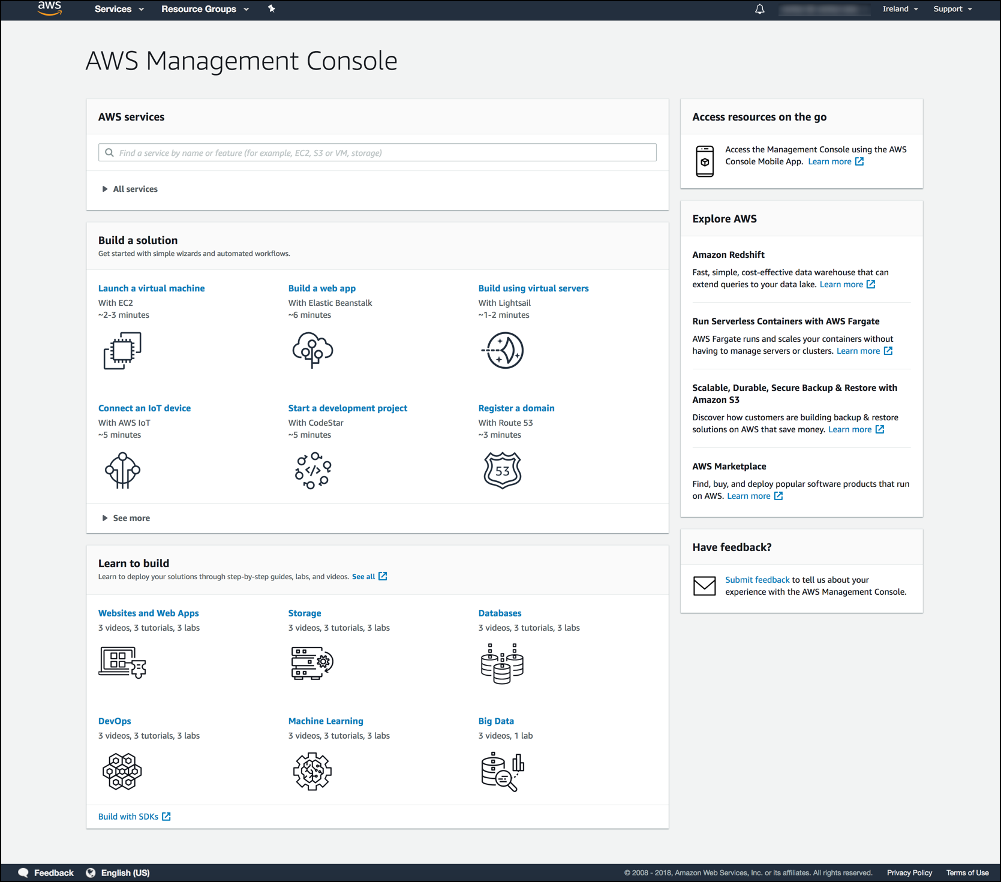
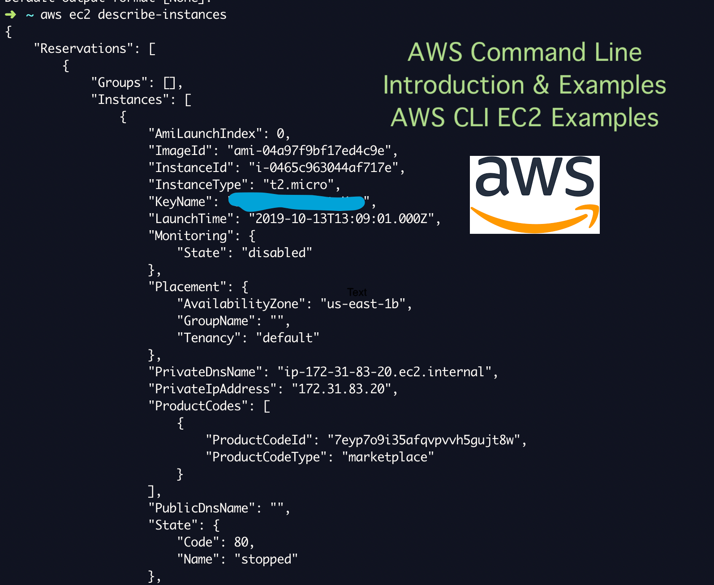
Ease of Use
AWS Console
Graphical interface
Access to AWS Services
API Access
Command line access
Interact programatically with AWS

Slide 19
Benefits of AWS
Flexability - choose as many AWS Services as you need, to support the needs of your application
Cost-Effectiveness – pay only for the amount of services you need. There are no long-term contracts or up-front commitments.
Scalability and Elasticity
Higly Available and Fault Tolerant

Slide 20

AWS Global Infrastructure

Slide 21
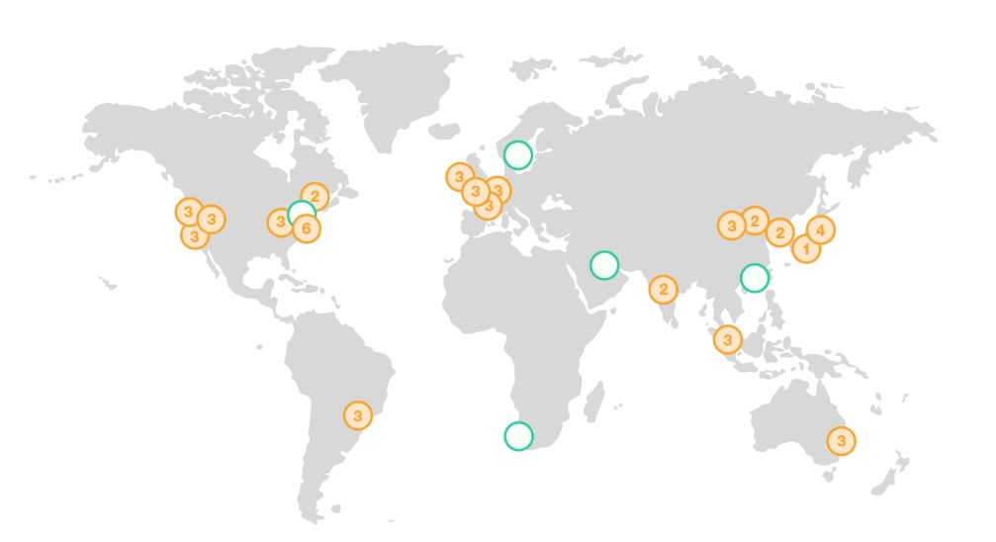
AWS Global Infrastructure
Regions
Availability Zones
Data Centers
AWS now spans 76 Availability Zones within 24 geographic regions around the world, and has announced plans for nine more Availability Zones and three more AWS Regions in Indonesia, Japan, and Spain.
https://www.infrastructure.aws/

Slide 22

Website Deployment Workshop

Slide 23
Workshop
Go to https://aws.amazon.com/console/
Follow the registration process
Your account will be active in the next 24 hours
The resources for the wokrshop will be available in the course page

Slide 24

Summary
…
…
…
In the Beginning, Before There Was a Cloud
Introduction to Cloud Terminology
Primary Benefits of Cloud/AWS
AWS Global Infrastructure
Website Deployment Workshop

Slide 25
Questions?
Notes:
25

Slide 26











SoftUni Diamond Partners

Slide 27



Educational Partners

Slide 28
Trainings @ Software University (SoftUni)
Software University – High-Quality Education, Profession and Job for Software Developers
softuni.bg, about.softuni.bg
Software University Foundation
softuni.foundation
Software University @ Facebook
facebook.com/SoftwareUniversity
Software University Forums
forum.softuni.bg
Notes:
28

Slide 29

License
This course (slides, examples, demos, exercises, homework, documents, videos and other assets) is copyrighted content
Unauthorized copy, reproduction or use is illegal
© SoftUni – https://about.softuni.bg/
© Software University – https://softuni.bg
Notes:
29

